Slide 1
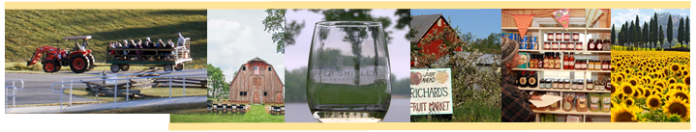
Virginia Agritourism
By: Livvy Preisser
6/2/2020

Slide 2


Objectives
Virginia Agritourism:
  Definition
  Importance
  Impact
  Opportunities
  Questions

Slide 3
Agriculture + Tourism
“Any activity carried out on a farm or ranch that allows members of the general public, for recreational, entertainment, or educational purposes, to view or enjoy rural activities, including farming, wineries, ranching, historical, cultural, harvest-your-own activities, or natural activities and attractions. An activity is an agritourism activity whether or not the participant paid to participate in the activity.” (Code of Virginia § 3.2-6400).
Virginia Decoded. (2008). Definitions. Retrieved January 16, 2017, from https://vacode.org/2016/3.2/V/64/3.2-6400/.

Slide 4
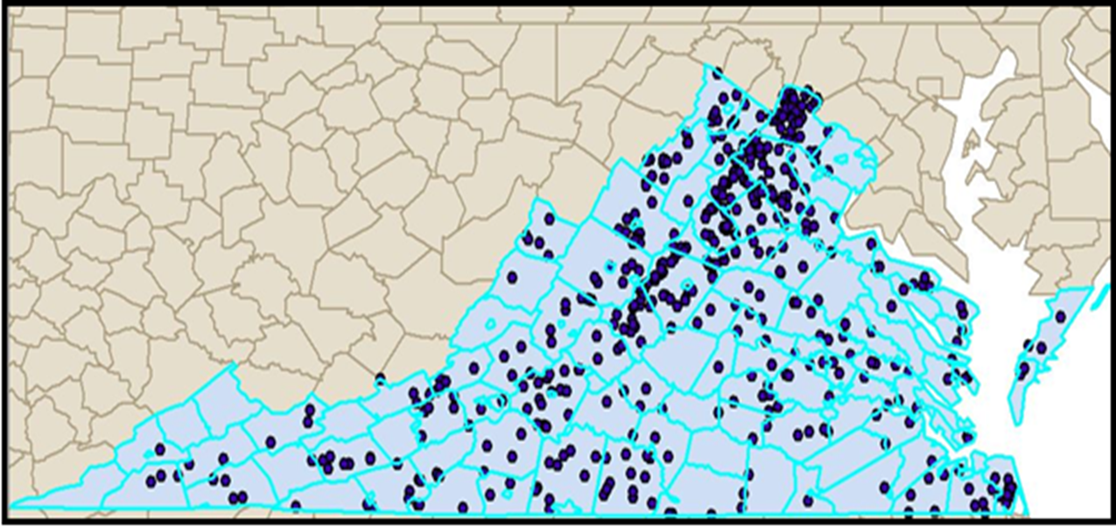
Virginia Agritourism Industry
Source: VDACS Virginia-Grown 2013; Pickyourown.org; extension agent correspondence (ArcMap 10.1)

Slide 5

Agritourism
Bed & breakfast
Trail rides
Breweries & wineries
Fall festivals
Corn mazes
Hay rides
U-picks or cut your own
Farm stores & markets
Weddings
Walker, M. (2009). Agritourism: Ideas and Resources. Retrieved January 16, 2017, from https://pubs.ext.vt.edu/310/310-004/310-004.html.
Magnini, V., Calvert, E., & Walker, M. (2017). The Economic and Fiscal Impacts of Agritourism in Virginia. Retrieved on March 4, 2017, from https://www.vatc.org/wp-content/uploads/2017/06/TheEconomicAndFiscalImpactsOfAgritourismInVirginia.pdf.

Slide 6
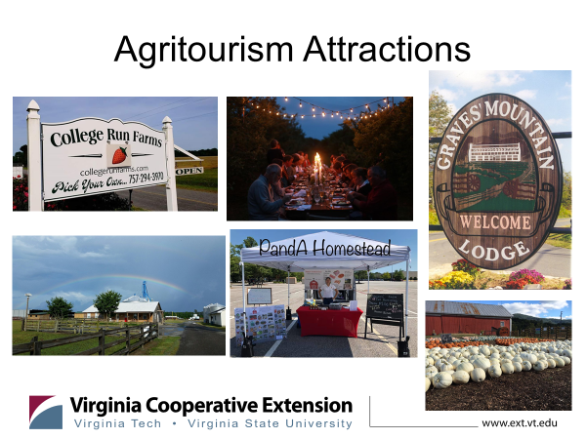
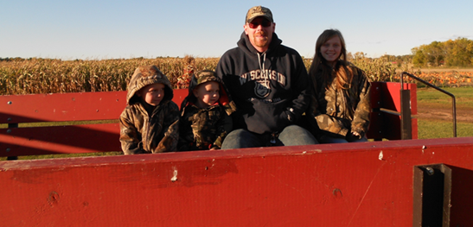
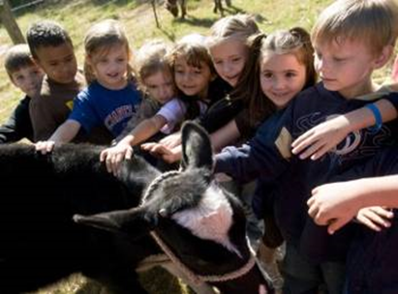
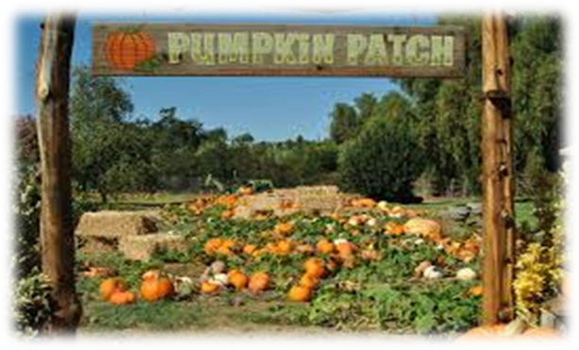
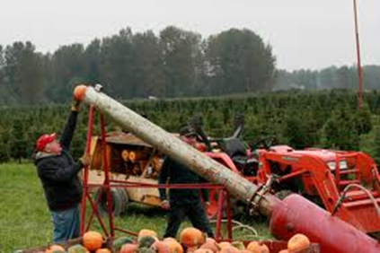

Slide 7

Getting Started
Business Plan
Layout of farm
Check Zoning and Planning/Permits
Insurance/Walkthrough
Other agritourism operations near you
Partnerships
Have fun

Slide 8

Why Agritourism?
Additional income
Market farm products
To share a lifestyle
Provide service/opportunity to the community
Availability of good food, fiber, and/or wine
Bonding with family and friends
Educational/experiencing something new
Enjoying the outdoors
Fun/entertainment
Live close by/passing through/ visiting friends or family in the area
Magnini, V., Calvert, E., & Walker, M. (2017). The Economic and Fiscal Impacts of Agritourism in Virginia. Retrieved on March 4, 2017, from https://www.vatc.org/wpcontent/uploads/2017/06/TheEconomicAndFiscalImpactsOfAgritourismInVirginia.pdf.

Slide 9
Impact
Magnini, V., Calvert, E., & Walker, M. (2017). The Economic and Fiscal Impacts of Agritourism in Virginia. Retrieved on March 4, 2017, from https://www.vatc.org/wpcontent/uploads/2017/06/TheEconomicAndFiscalImpactsOfAgritourismInVirginia.pdf.

Slide 10
Visitor Impact

Slide 11
Economic Impact-Travelers

Slide 12
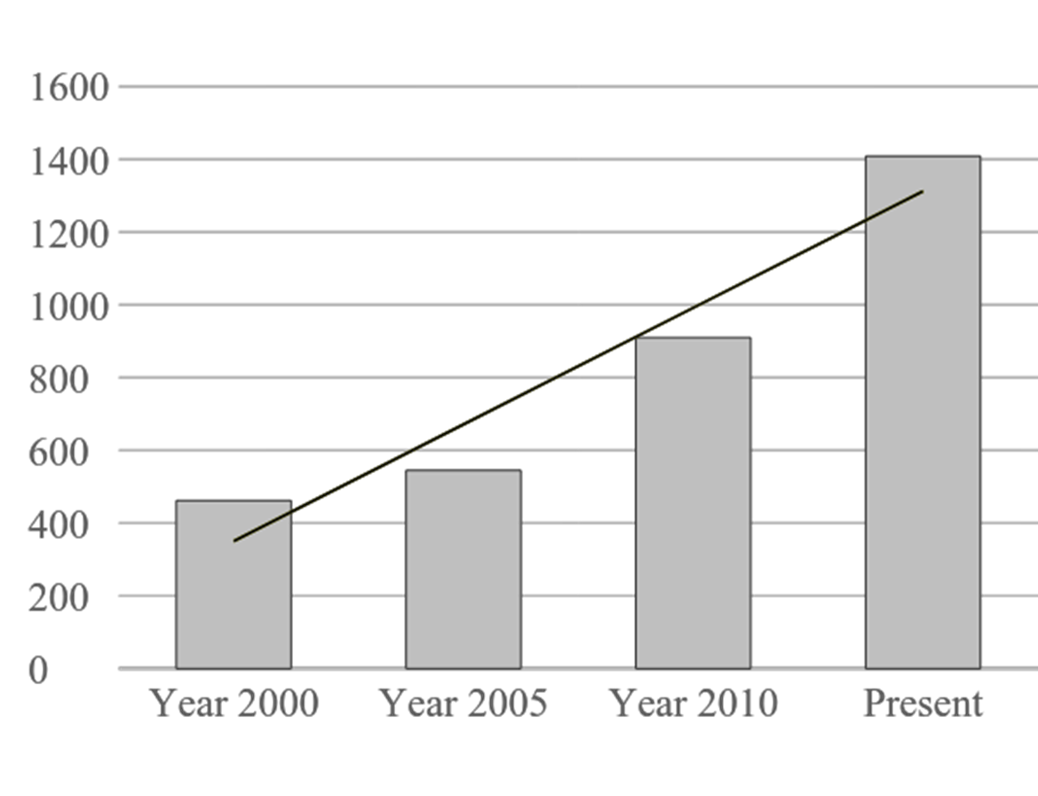
VA Agritourism Growth

Slide 13
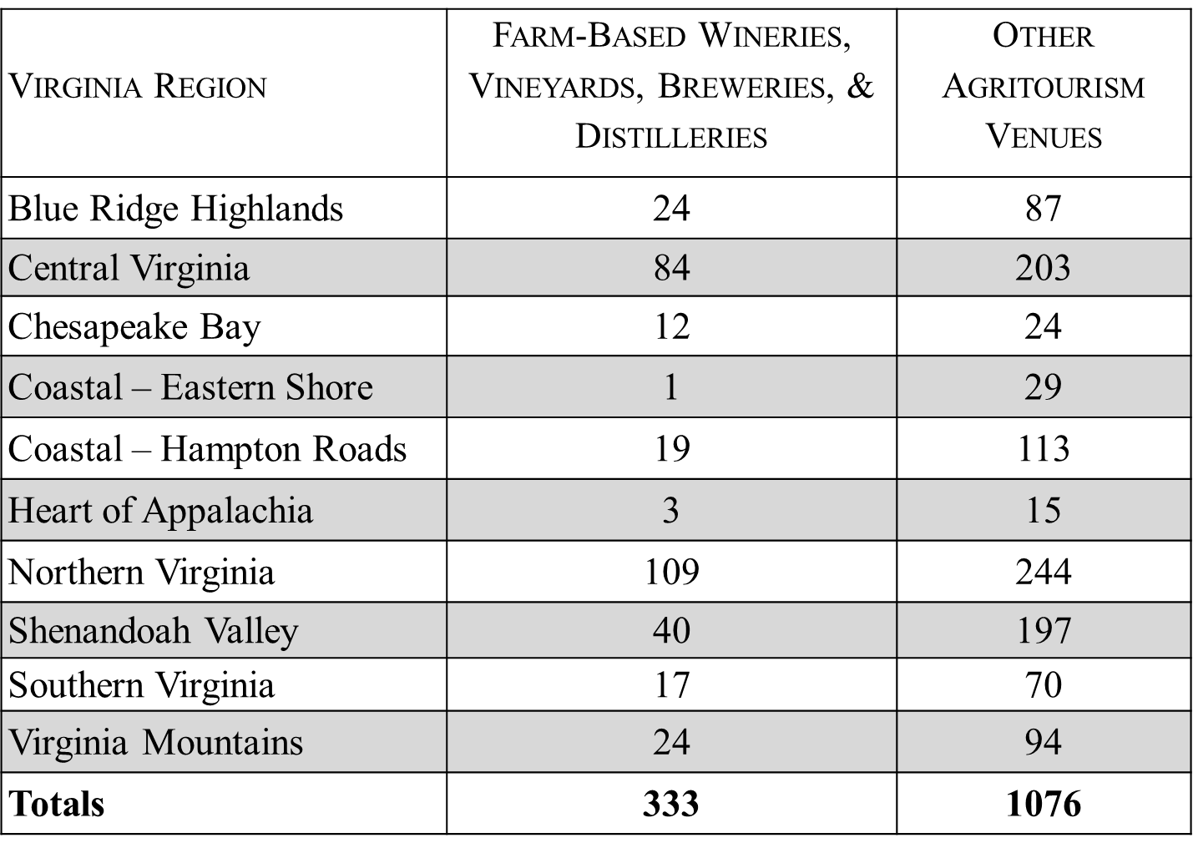
VA Agritourism Inventory

Slide 14
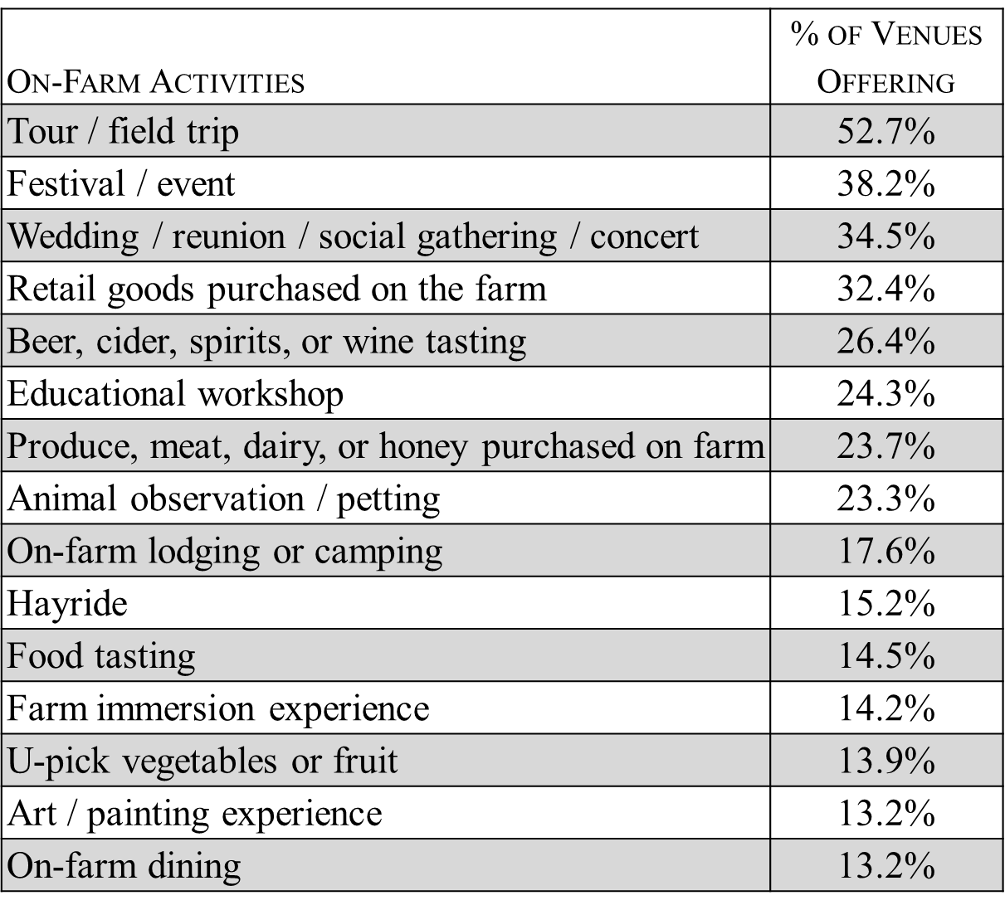
VA Agritourism

Slide 15
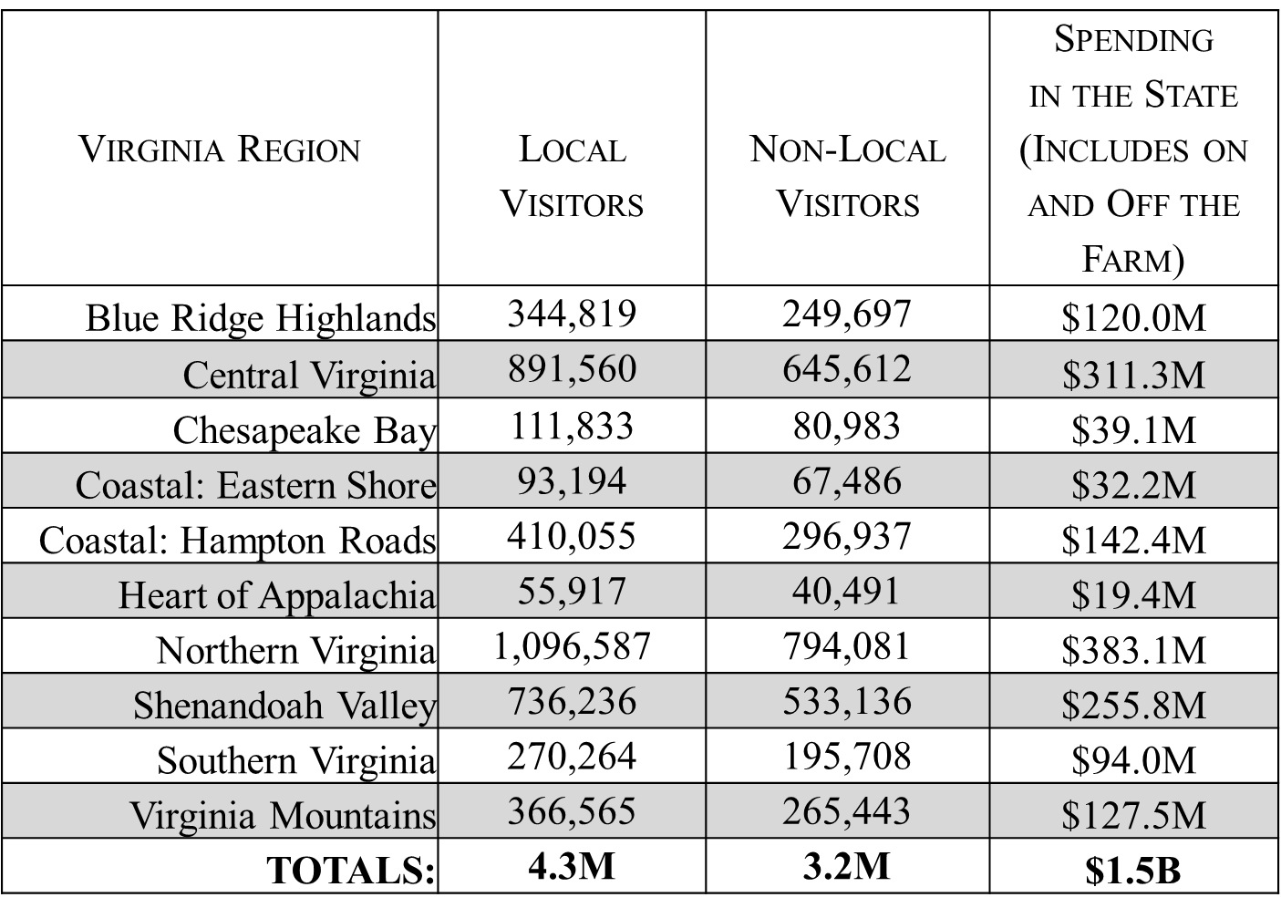
Visitor Spending

Slide 16
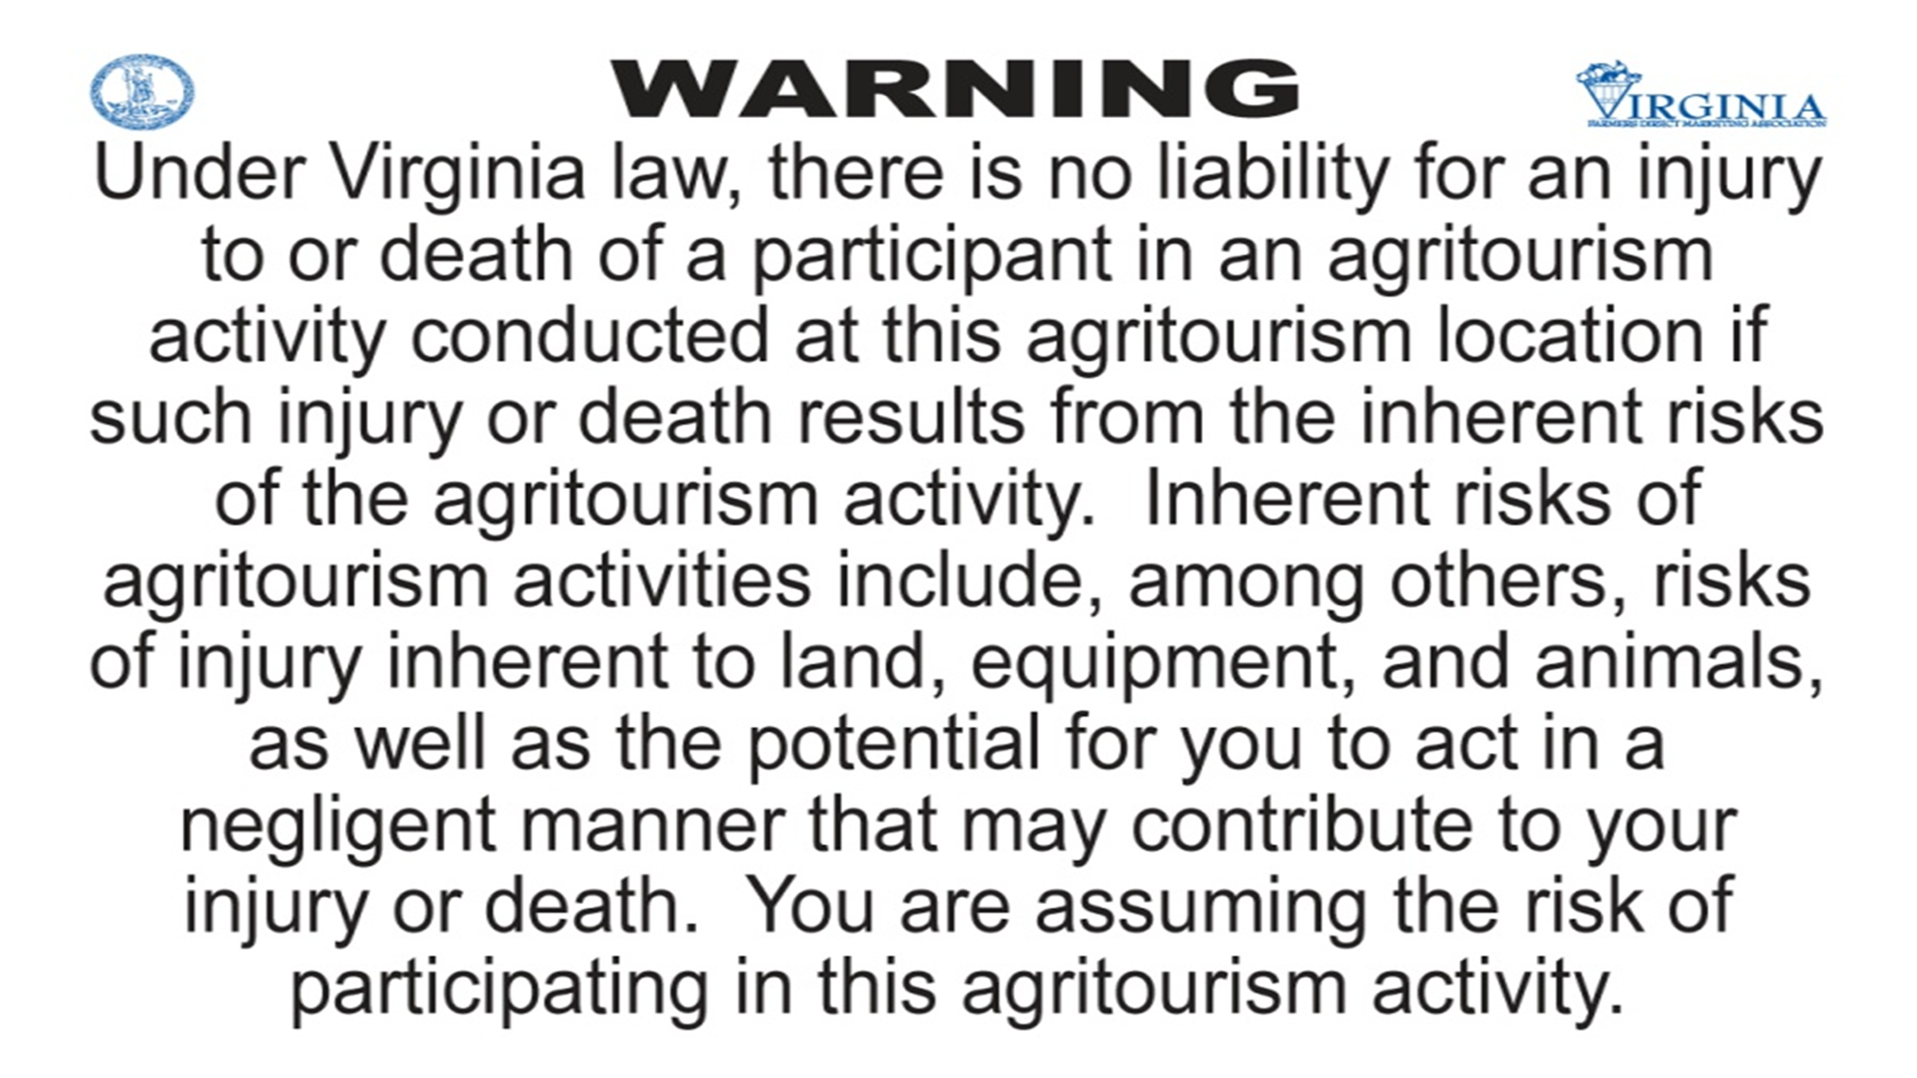

Opportunities
Liability
Insurance
Safety

Slide 17
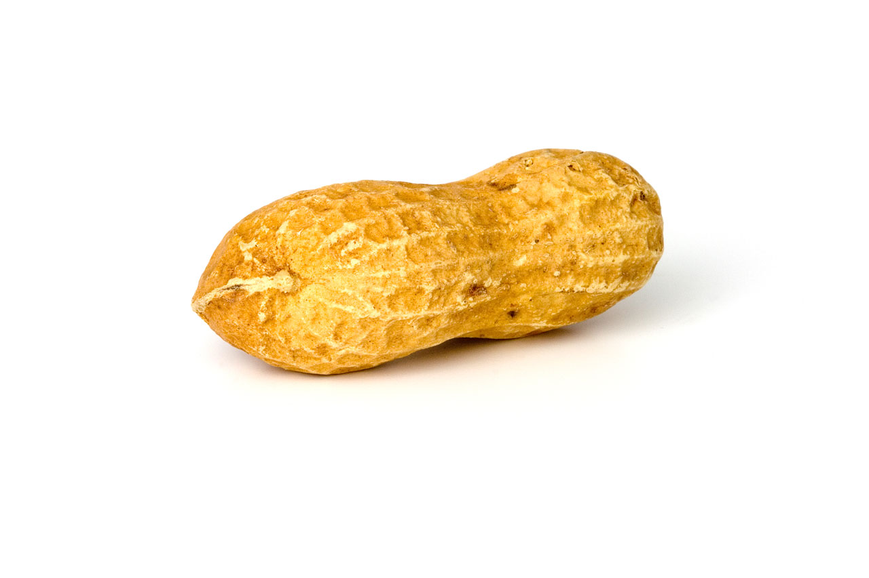
Visitor Safety Concerns
Unfamiliar with agriculture
Looking for a babysitter
Easily distracted
The rules “don’t apply to me”
Common sense is “dead”
National Children's Center

Slide 19

Insurance
  Need insurance
  Walkthroughs

Slide 20

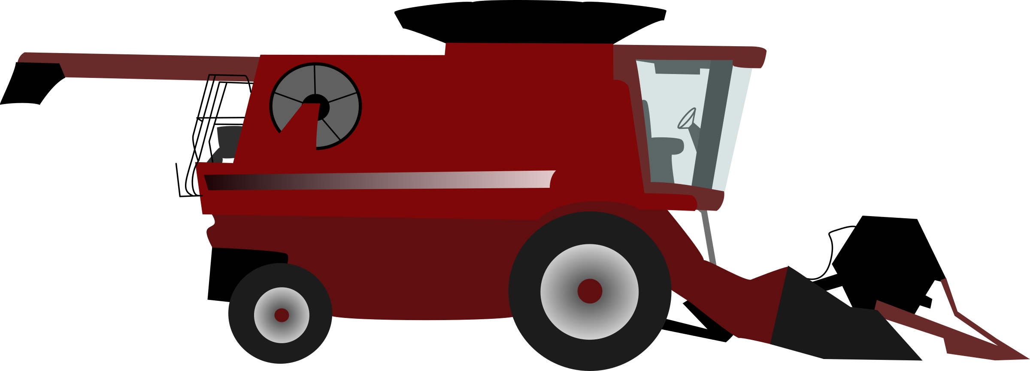
Safety
  Walkthroughs
  Training
  Signage (words and pictures)
  Farm layout

Slide 21
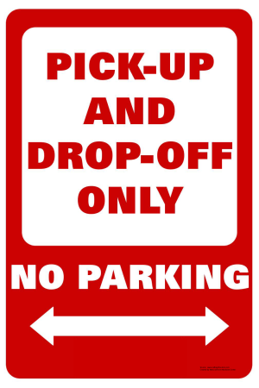




Resources
https://ext.vt.edu/agriculture/agritourism.html
https://safeagritourism.org/

Slide 22
Thank you!
“Virginia is a top ten destination for travelers, largely due to the diversity of product and the authenticity of offered experiences and agriculture is a key part of that variety. From aquaculture operations along our coastlines to wineries along the slopes of our mountains, travelers in Virginia can truly immerse themselves through sight, touch, and taste of all that Virginia agriculture has to offer. These authentic, experiential moments make it easy for travelers to discover why Virginia is for Lovers.”
-Todd Haymore, Secretary of Commerce and Trade

Slide 23
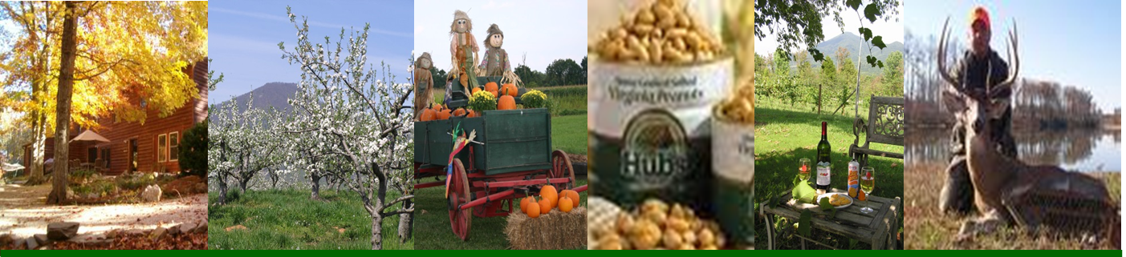
Livvy Preisser
ANR- Isle of Wight livvy16@vt.edu
(757)365-6261 https://ext.vt.edu/agriculture/agritourism.html

