Slide 1
Agritourism Safety in Virginia
By: Livvy Preisser
Agritourism Education Series Zoom
6/23/2020

Slide 2
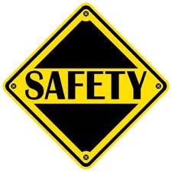
Farm Safety
23,883,000 youth visited farms in 2014
3,735 visiting youth were injured on farms in 2014
Every day about 33 children are injured in ag incidents
NIOSH (2016). Analyses of the 2014 Childhood Agricultural Injury Survey (CAIS).
Morgantown WV: U.S. Department of Health and Human Services, Public Health Service, Centers for Disease Control and Prevention, National Institute for Occupational Safety and Health, Division of Safety Research. Retrieved on March 4, 2017, from https://www.marshfieldresearch.org/Media/Default/NFMC/PDFs/2016-Child-Ag-Injury-Fact-Sheet.pdf.

Slide 3
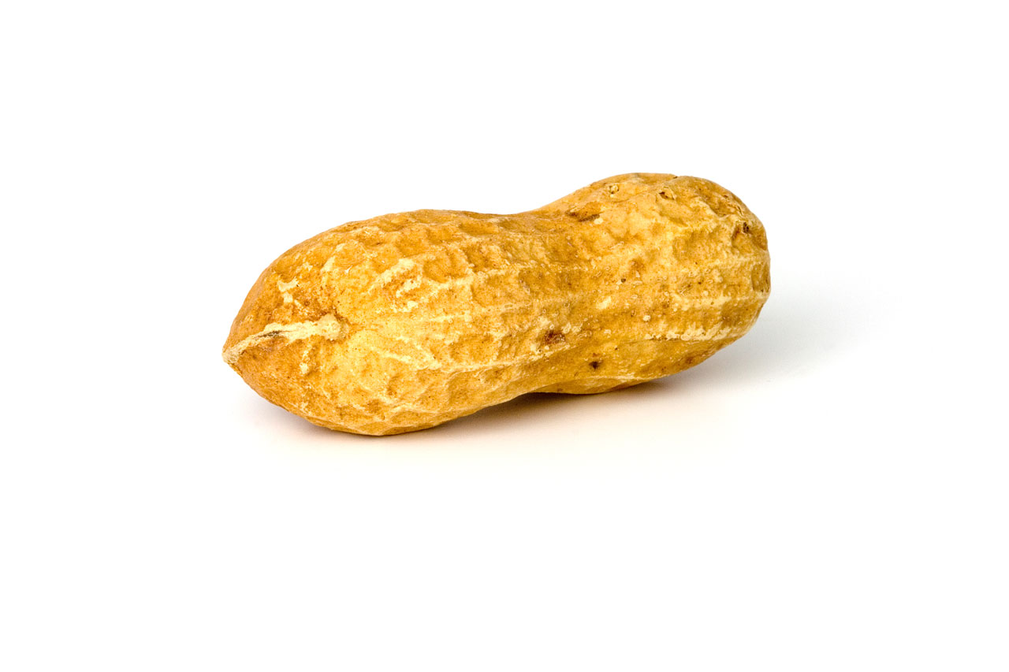
Why are visitors a safety issue?
Unfamiliar with agriculture
Looking for a babysitter
Easily distracted
The rules “don’t apply to me”
Common sense is “dead”
National Children's Center

Slide 4
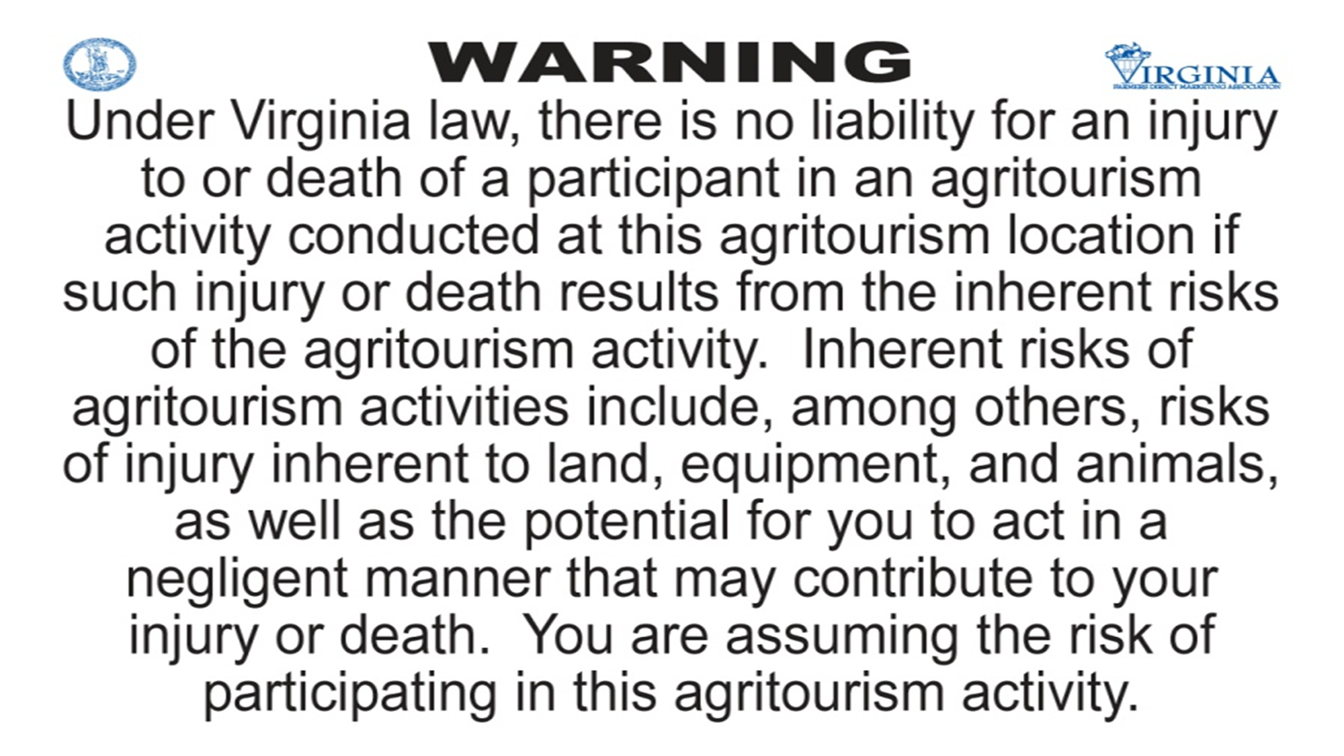

Opportunities
Liability
Insurance
Safety

Slide 5

Research
What types of safety protocols are in place for visitors, how are they managed on Virginia agritourism operations, and how could they be improved for future operations?
Look at current safety protocols:
  Farm employees
  Farm visitors
  Insurance
  Signage

Slide 6
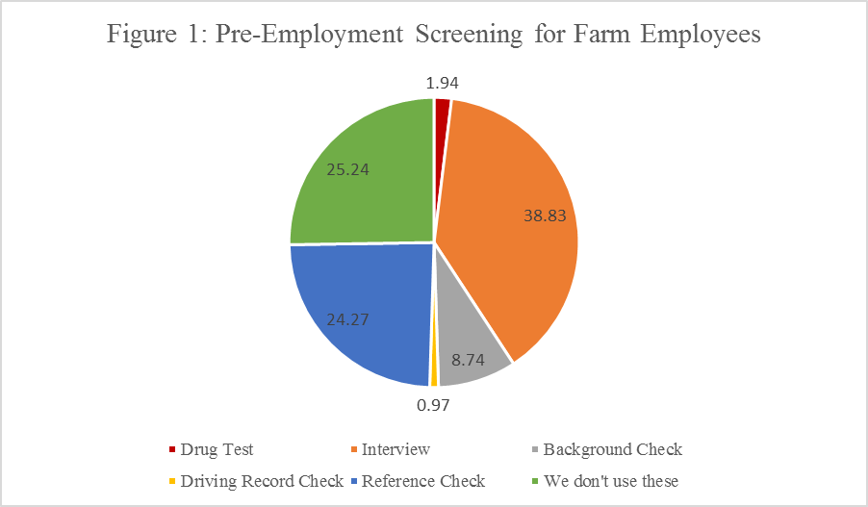
Farm Employees

Slide 7

Farm Visitors
Sanitary Stations:
  43% permanent bathrooms
  30% utilize hand sanitizer
  26% offer porta johns
  2% do not offer bathrooms
Emergency/911:
  43% would call 911
  30% would call the manager
  17% meet at central location
  10% no emergency plan

Slide 8

Farm Visitors
Layout of the farm:
  17% Local fire
  11% Local EMT
  12% Local police
  60% No layout to emergency personnel

Slide 9

Insurance
Coverage:
  83% have coverage
  13% have insurance without agritourism coverage
  4% no insurance

Slide 10
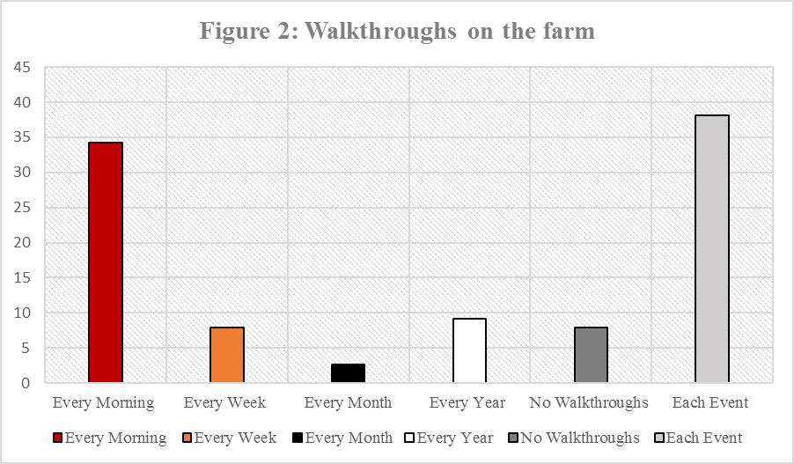
Insurance

Slide 11
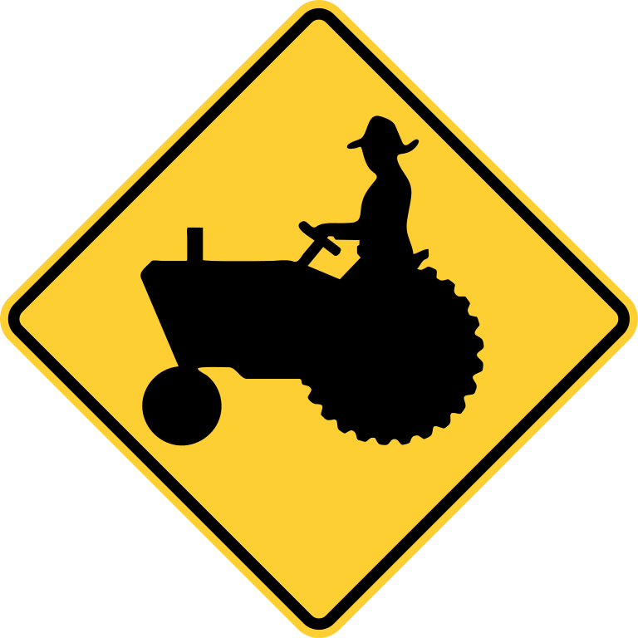
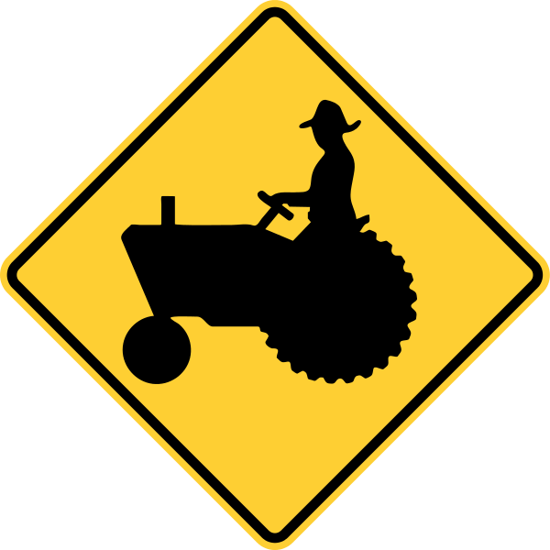
Signage
Liability Sign:
  78% posted in 1-5 areas
  6% posted in 5-10 areas
  14% do not have the sign
Location:
  48% @ entrance
  20% in parking area
  28% @ activity area
  Different languages
    Pictures & words

Slide 12
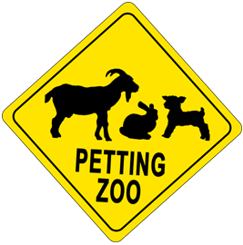
10 visitors Sickened at Petting Zoo
Petting zoo & pumpkin patch
Illness traced back to the farm
Lab test confirmed 5 cases of E.coli
5 others suffered stomach issues
Hand sanitizers were present next to the animals, but no handwashing stations

Slide 13

Questions?
Were there signs posted warning visitors of the illness hazards?
Was the petting zoo set up so traffic is “one way”
Were the buildings and stalls cleaned regularly?
Were the animals kept clean?

Slide 14

Could this have been prevented?
Petting zoo traffic flows in a one way pattern
Handwashing stations with soap and warm running water are available at the exit
Handwashing signs posted by the station
Buildings and stalls regularly cleaned and sanitized
Animals are clean, healthy, and UTD on vaccinations

Slide 15
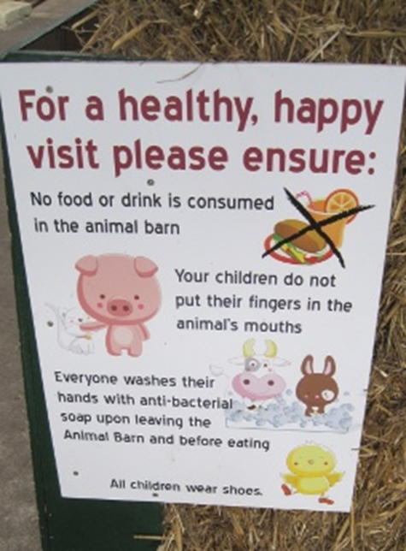
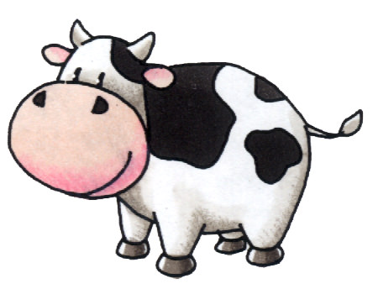
Prevented…
Signs at the entrance should warn visitors that there is not eating or drinking allowed
A trash can is available to discard food and drink
Cups, bottles, pacifiers, and toys should not be allowed in the animal areas

Slide 16

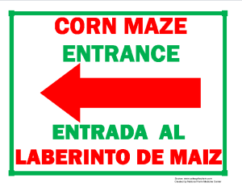


Resources
https://ext.vt.edu/agriculture/agritourism.html
https://safeagritourism.org/

Slide 17

If you are interested…
Go visit other farms for ideas
Check with your county/city codes
  Get permits/license if needed
Talk to your local extension agent
Talk to your insurance agent
  Have a business plan and emergency plan
  Have appropriate signage/walkthrough
Remember your target audience/market
  What will people pay for and interested in?
  Create a website and social media accounts
Don’t be afraid to try new things
Stay positive and have fun! ☺

Slide 18
Takeaway Points
  Agritourism must be on a farm
  Several considerations before starting
  Do your research!!!
  Don’t be afraid to ask questions???
  Have fun! ☺

Slide 19
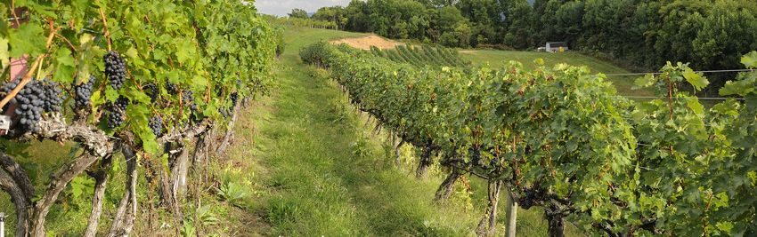
Virginia Tech Resources
https://ext.vt.edu/agriculture/agritourism.html
Livvy Preisser, ANR- Isle of Wight, livvy16@vt.edu, 757-365-6261

